Slide 1
Basics of Port Addressing
Dr.Mohammed Abdalla Mahmoud Youssif
1

Slide 2

2
Notes:
2

Slide 3
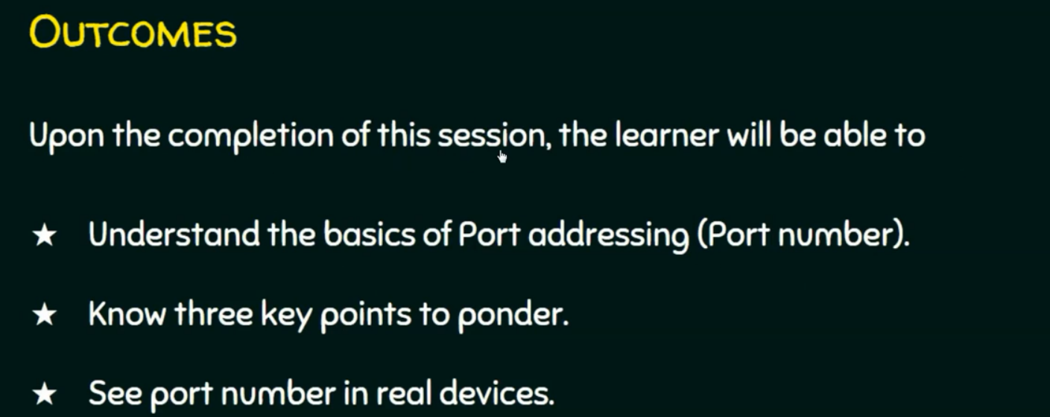
3
Notes:
ponder تأمل
3

Slide 4
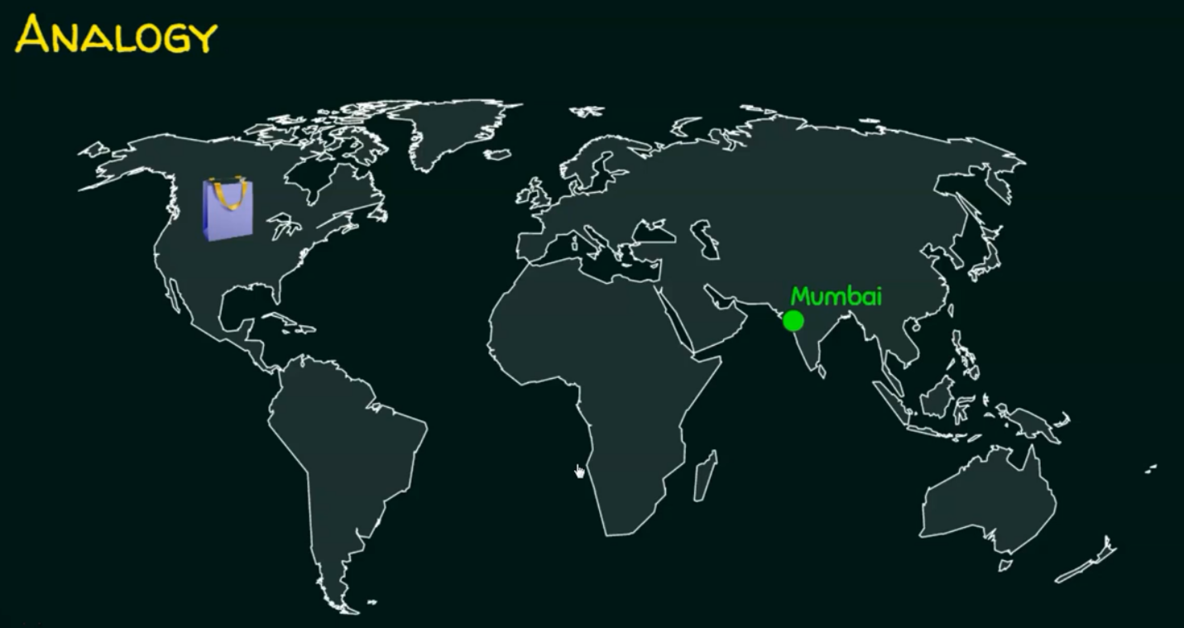
4
Notes:
I need a compete address to send the message.
4

Slide 5

5
Notes:
I need a compete address to send the message.
5

Slide 6
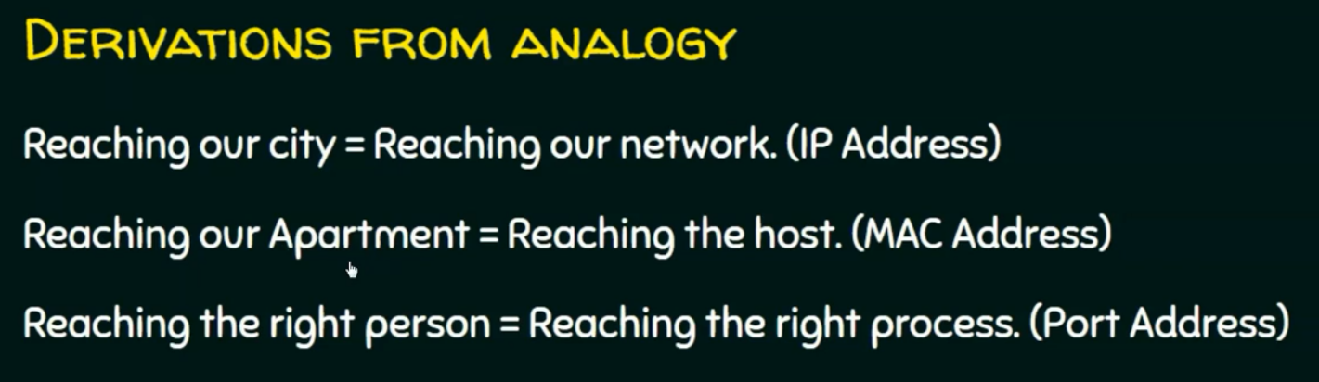
6
Notes:
Analogy → متشابه
I need to reach a specific process.
6

Slide 7
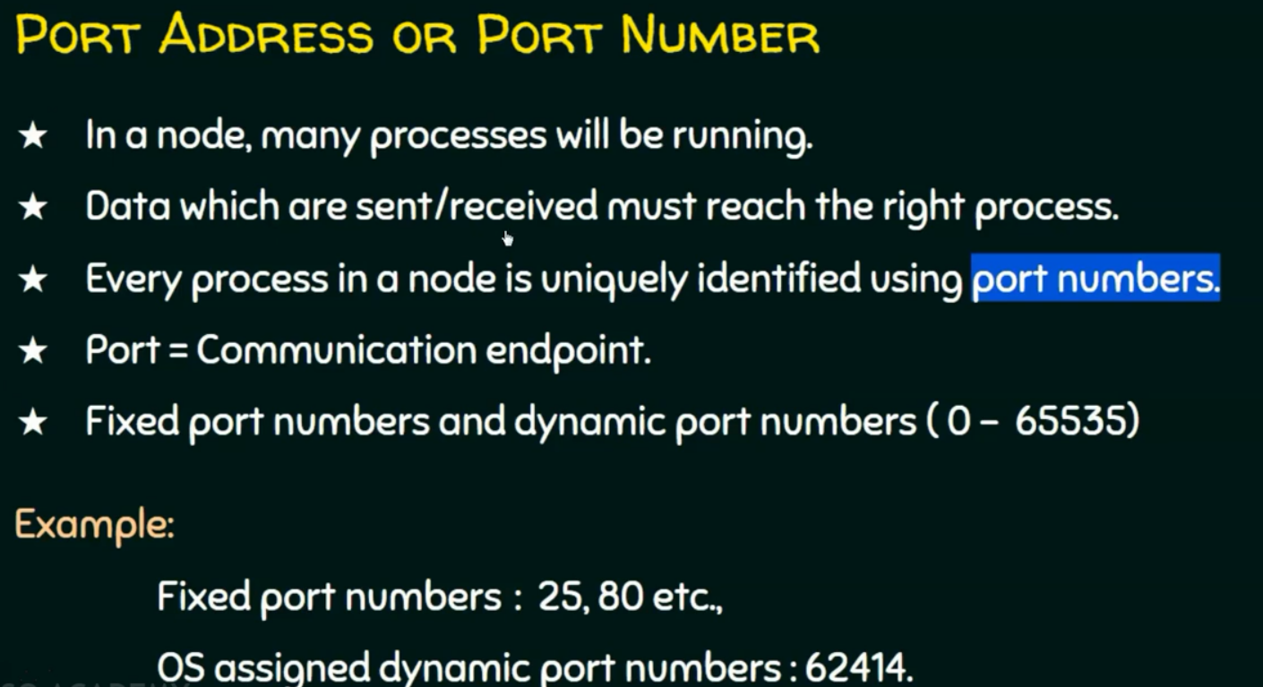
7
Notes:
7

Slide 8
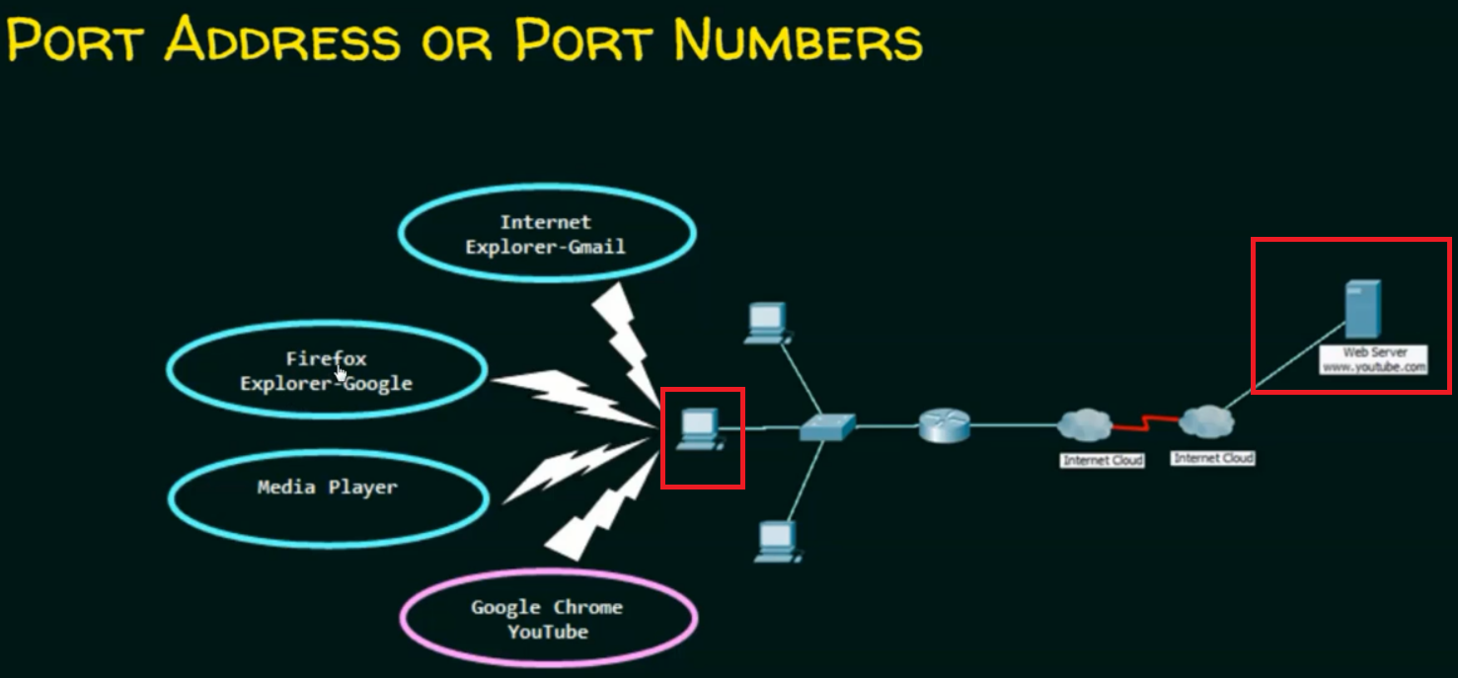
8
Notes:
- different processes are running. → Gmail on internet explorer and so on.
- IP address take me to the router, then the mac address take me the switch to identify the pc, then port address will go to reach specific process.
8

Slide 9
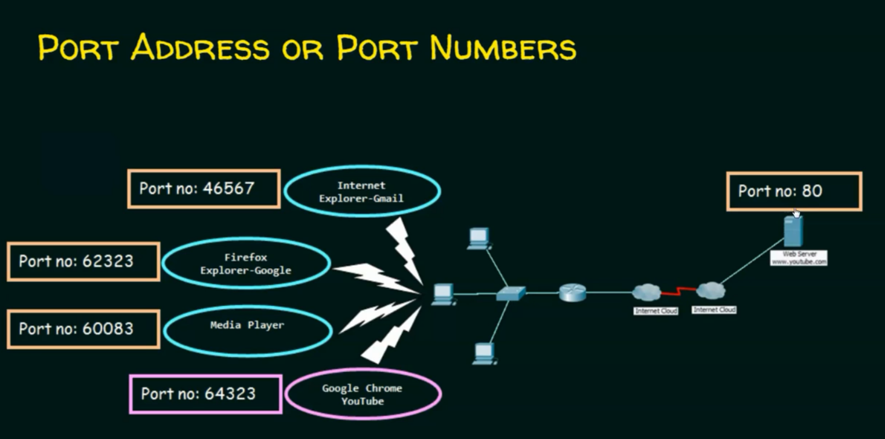
9
Notes:
9

Slide 10
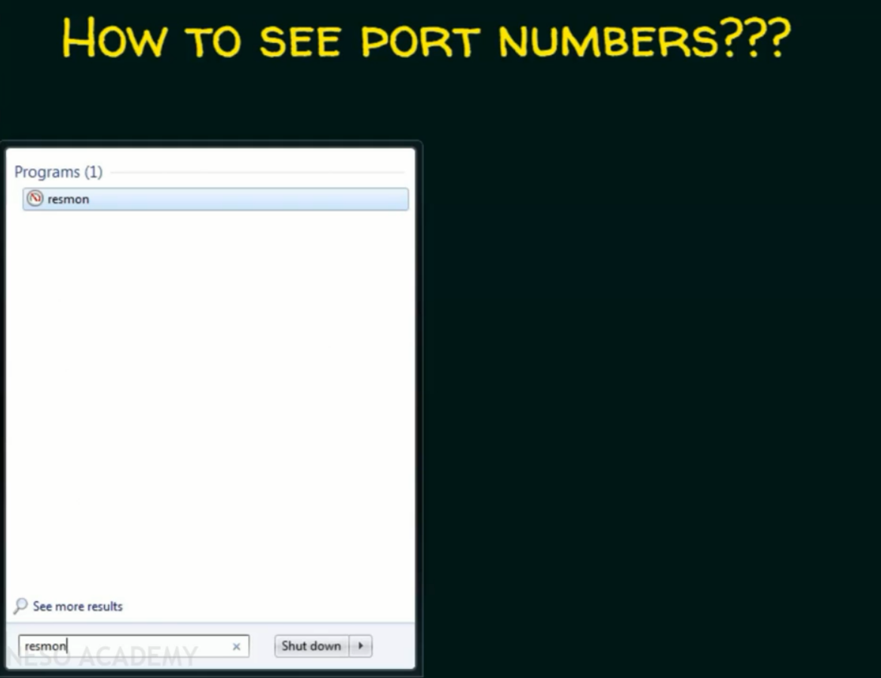
10
Notes:
10

Slide 11
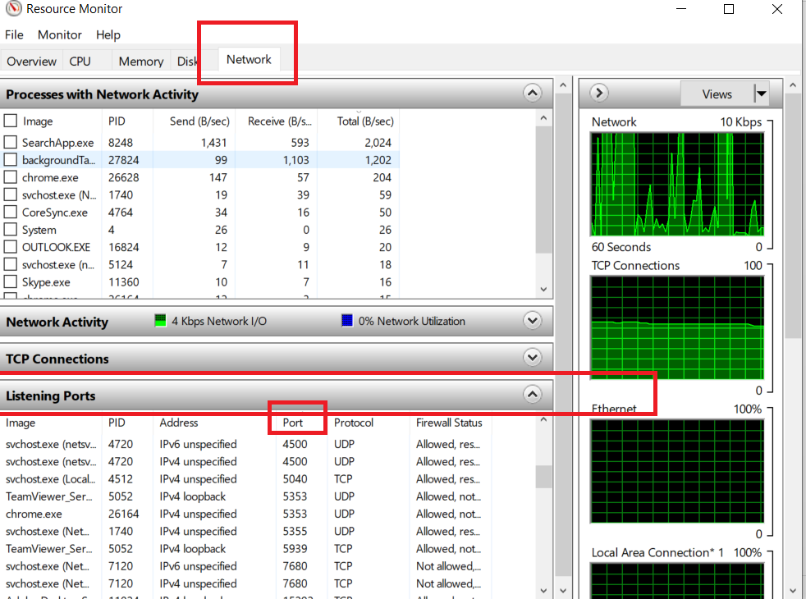
11
Notes:
11

Slide 12
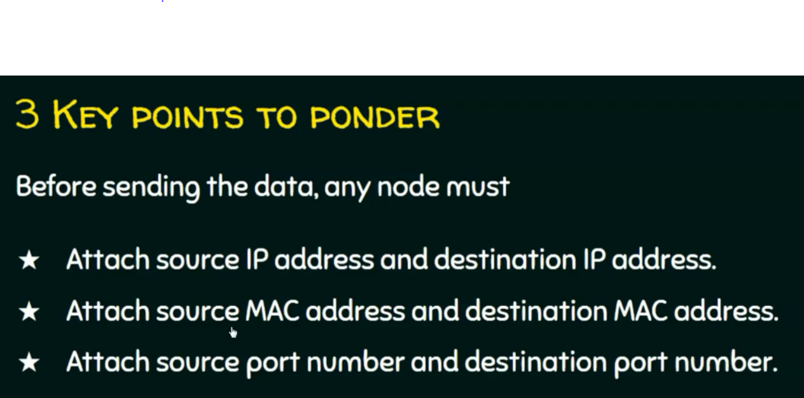
12
Notes:
12

Slide 13
Questions ?
13
Notes:
13

